Slide 1
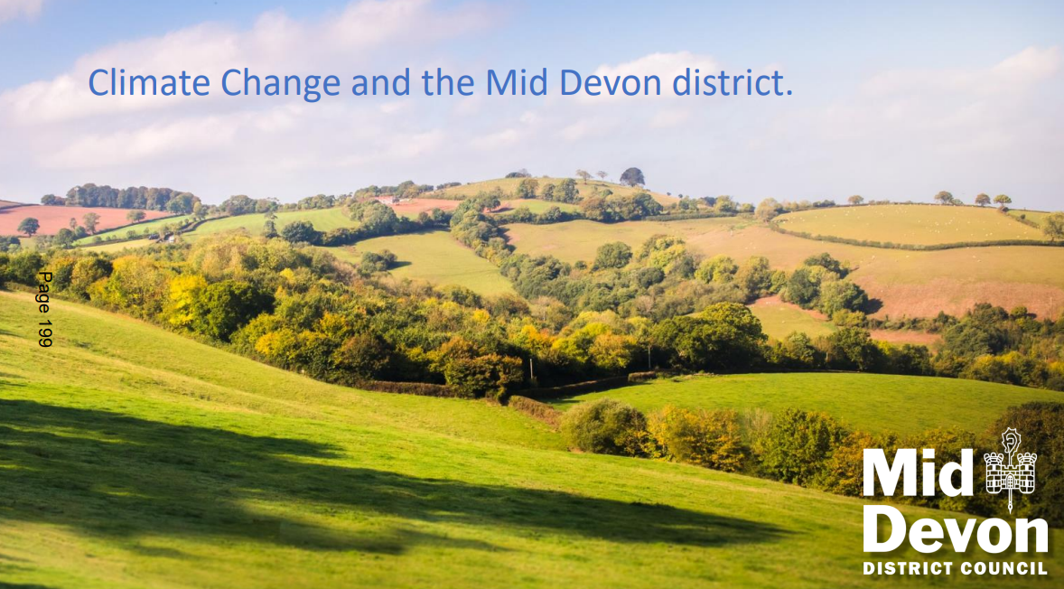

Slide 3
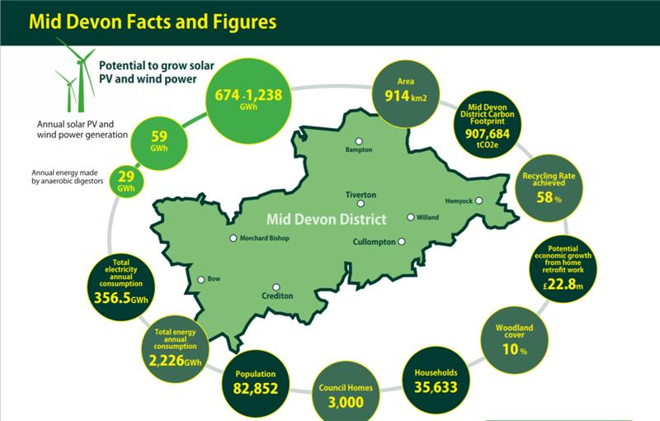
How can Local Authorities help deliver?
…via strategies for climate change and biodiversity?
Biodiversity Duty (2023)
Levelling Up and Regeneration Act (LURA)- section 245- ‘must seek to further the purpose’ [within the Blackdown Hills National Landscape]
Climate Change Strategy 2024-28
Local Nature Recovery Strategy- Devon (& Somerset)
Appropriate management of MDDC assets
Notes:
Renewable energy potential
BNG requirements in planning
Green Enterprise Grants

Slide 4
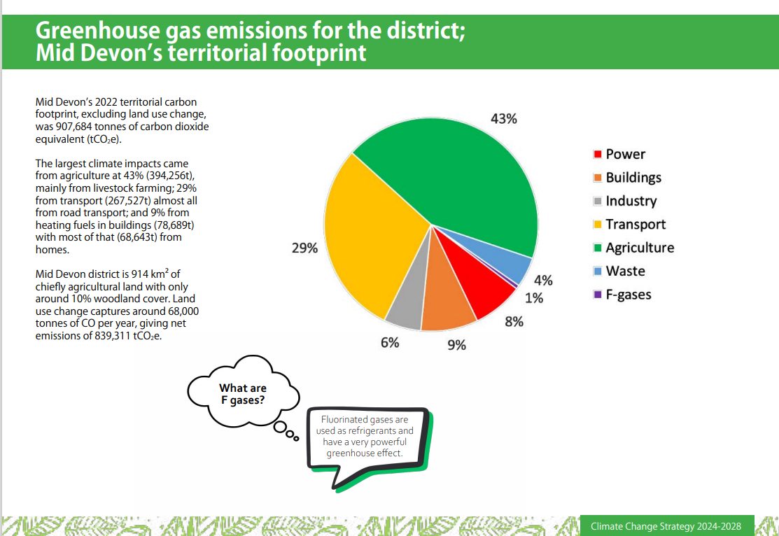

Slide 5
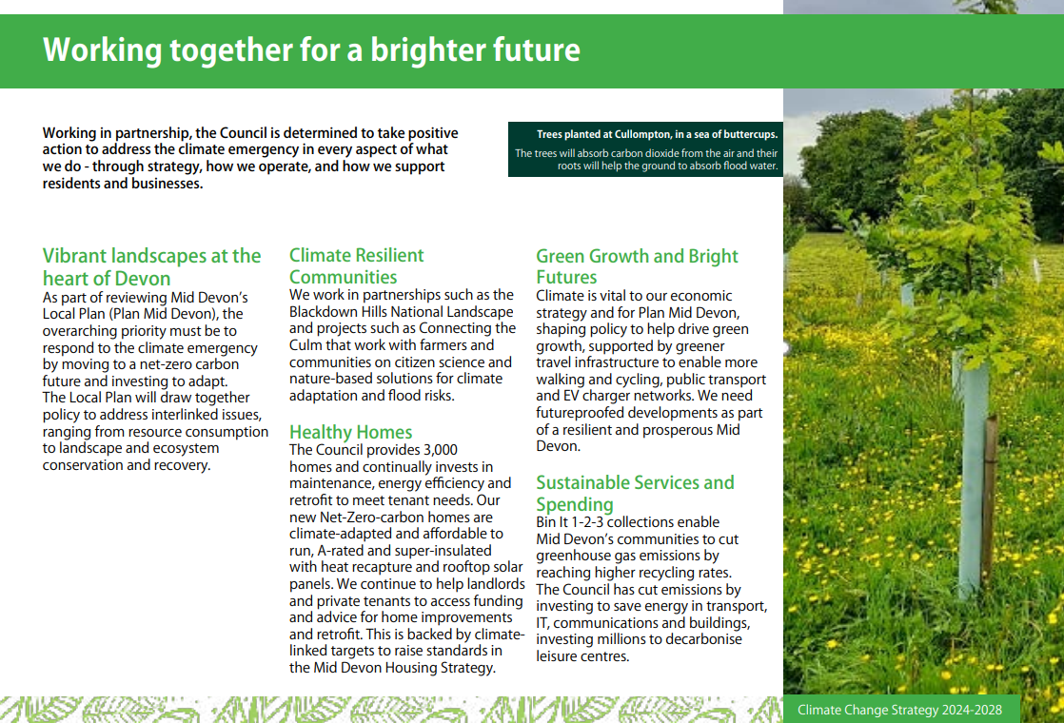
Notes:
Meeting our Corporate Plan
Linking our Corporate Strategy to the
Climate Strategy and the Devon Carbon Plan
5 priorities
Landscape, green growth, climate resilient communities

Slide 6
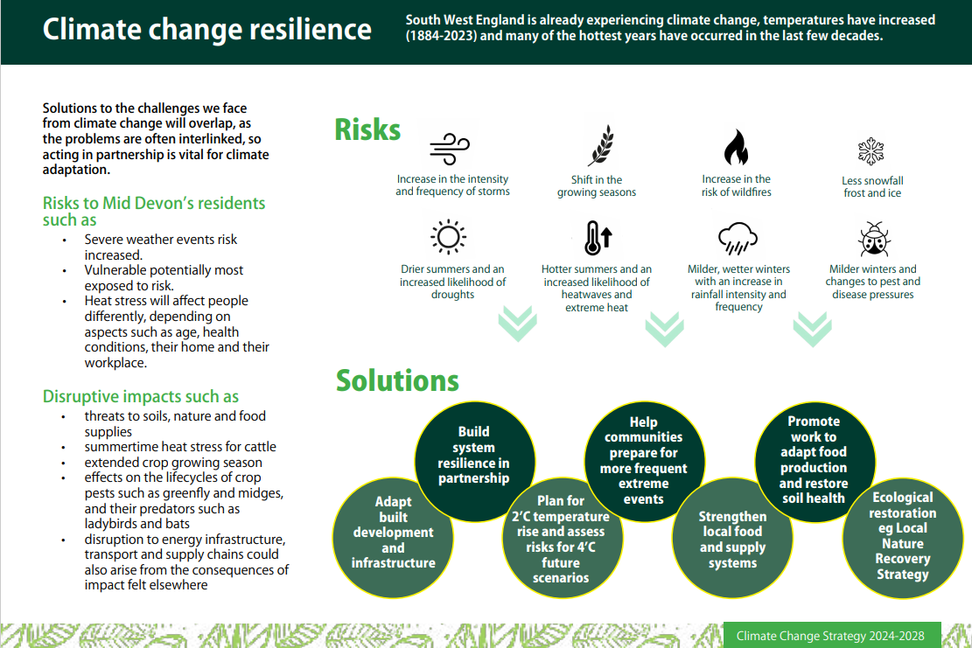
Notes:
Resilience:
Risks to residents: water quality & flooding disruption – prepare for more extreme events
Partnership working vital
LNR, restore soil health, strengthen local food supply & adapt local infrastructure
…inc catchment approach.
Build resilience across the catchment (for property, business & infrastructure), via extensive nature-based solutions working with land managers, that restore natural processes
Help communities to adapt to climate change, e.g. helping them be ‘flood ready’ and improving community resilience
Engage communities to raise awareness and build understanding about climate change
Restore important habitats and species populations
Encourage people to enjoy the natural world and celebrate rivers

Slide 7
Notes:
2025 projects include
evaluating how to improve energy efficiency at Phoenix House
installing more low-carbon and renewable energy at leisure centres (combined heat and power; battery storage)

Slide 8
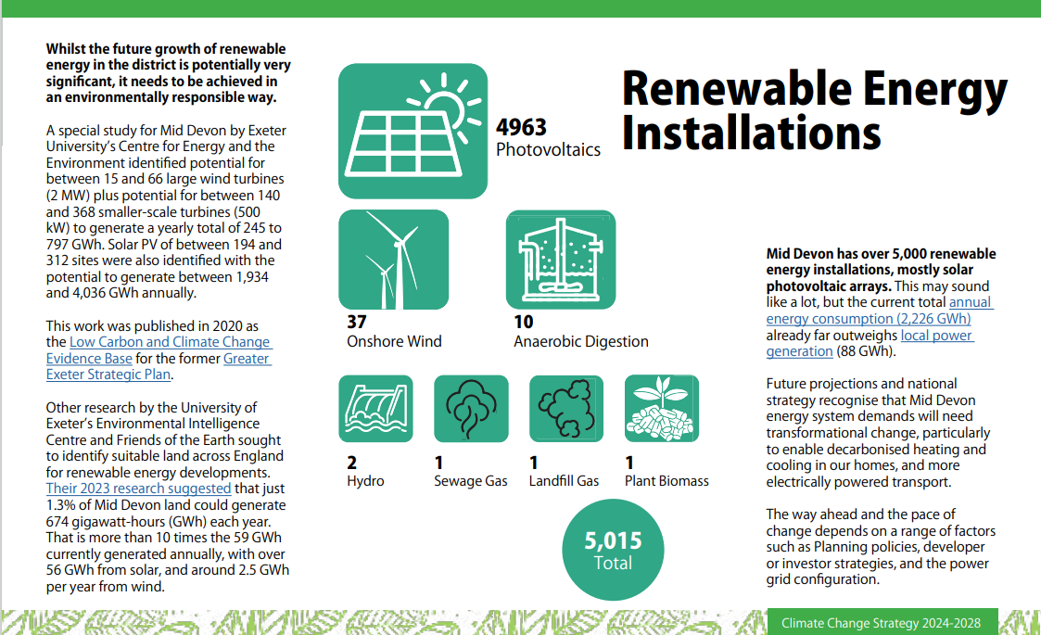

Slide 9
Climate strategy and action plan
climate-strategy-mddc-24-28-final-format.pdf
Notes:
Our Climate Strategy approved in January 2025 and 1st 5-year Action Plan 2025-30.
A starting point for engagement with communities, businesses and other partners, to co-create a vision for a sustainable future.
community / partnership working:
Energy Boost Mid Devon, our partnership project with ECOE Advice.
The council’s Green Enterprise Grant scheme. SME capital grants £500 to £5k.
For Hemyock and Upper Culm Parishes, we are working in partnership with the Connecting the Culm partnership (based in Hemyock).

Slide 10
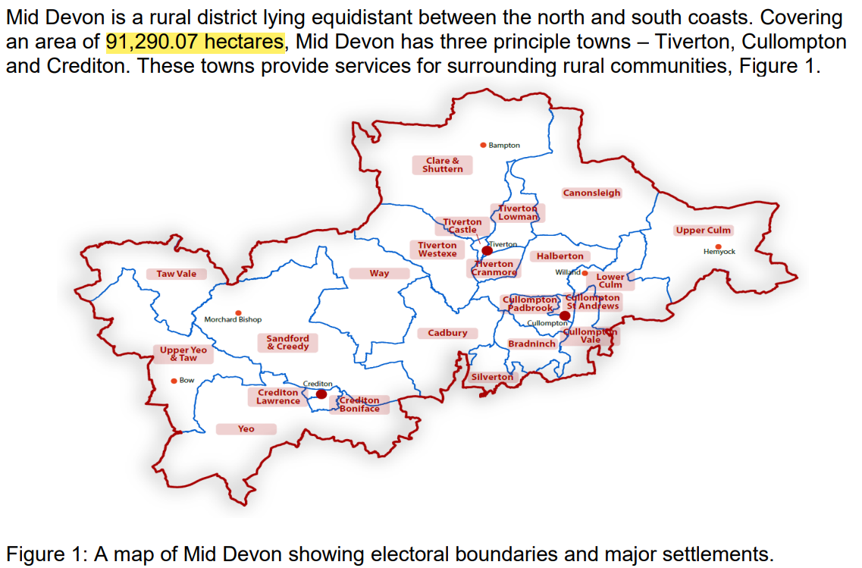
Notes:
What we do:
We DON’T do roads, or the LNRS, and DCC are the Lead Local Flood Authority.
BUT we DO…
Recycling
Leisure
Homes
Local Planning Authority & work with Parish/Town Councils for Neighbourhood Plans
Biodiversity Duty across all council services
Climate resilience & through development control can influence BNG

Slide 11
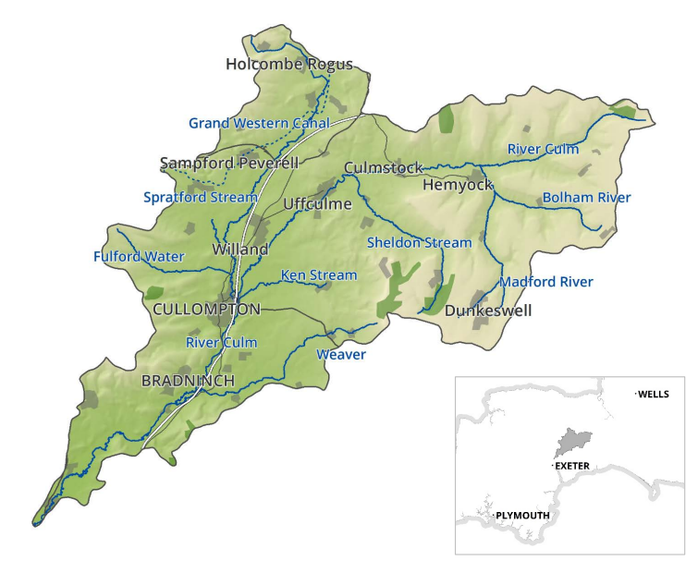
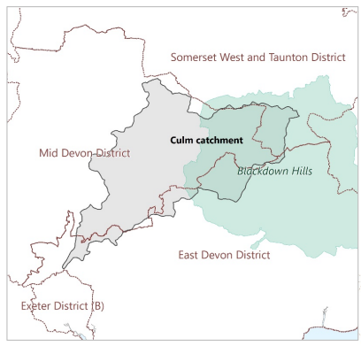
Notes:
The Culm catchment…
Eastern half of Mid Devon is in the Culm catchment
It’s fantastic to see Connecting the Culm recognising this special river…and it’s catchment:
- 27 miles
- 87% farmland
- 30,000 people
- 100 square miles

Slide 12
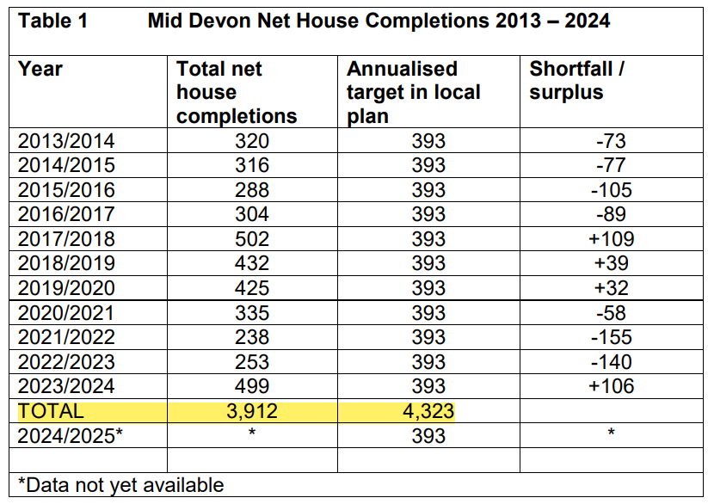
Notes:
Housing targets increasing: from 393 to around 500/year, every year.
East Cullompton – Phase 1 2500 but could be up to 5000 in new Local Plan.
Eastern Urban Extension Tiverton
Rural areas > pressure within and beyond village boundaries.

Slide 13
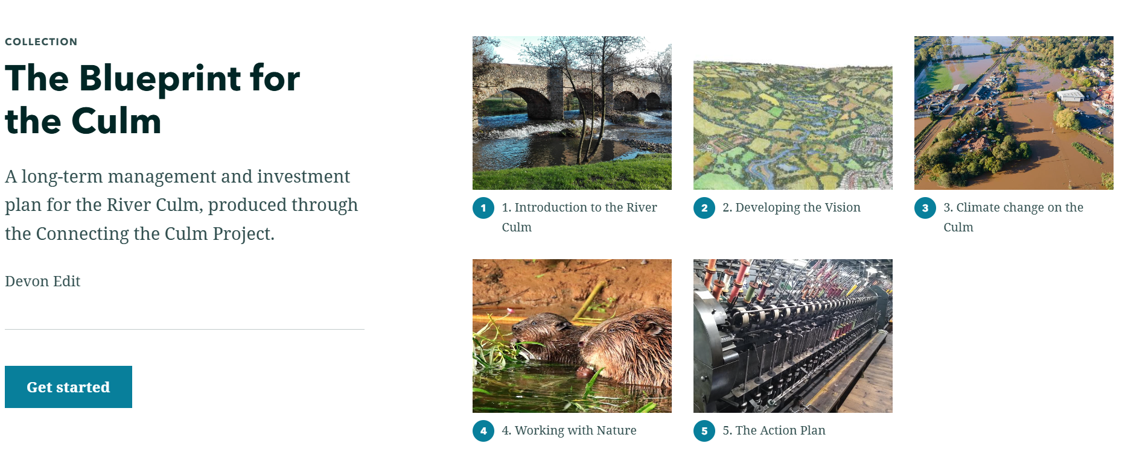
Notes:
Climate change – delivery area 3

Slide 14
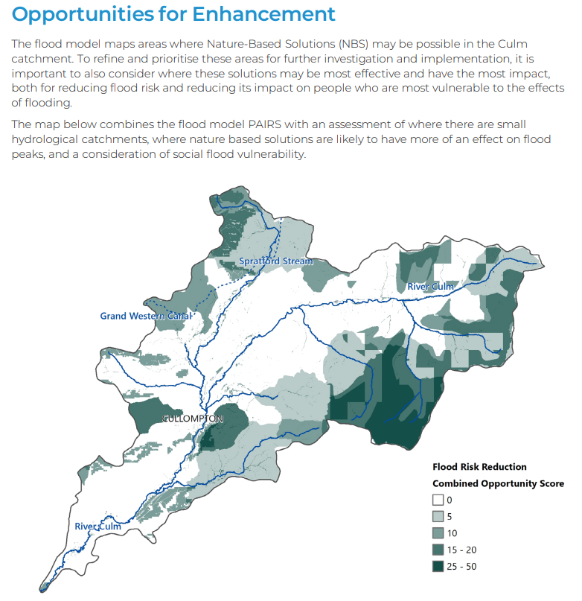
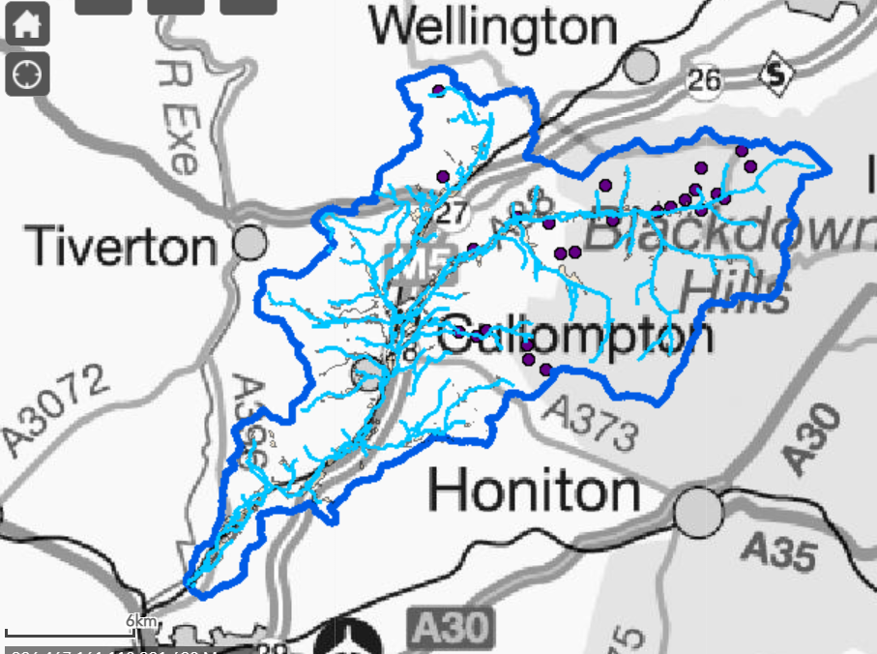
Notes:
Can we meet this development pressure without further compromising the Culm?
New Local Plan
There is legal requirement for local plans to be reviewed at least every five years, and for plans to be updated as necessary. A new local plan will ensure Mid Devon will continue to benefit from a plan-led approach for development to meet current and future needs over a longer time period beyond 2033. The Council is preparing a new local plan (with the working title ‘Plan Mid Devon’)…see link below:
Plan Mid Devon - MIDDEVON.GOV.UK
See Plan Mid Devon Issues Paper – January 2022….identifies 6 top priorities.
Site allocation work currently underway….through the PPAG.

Slide 15
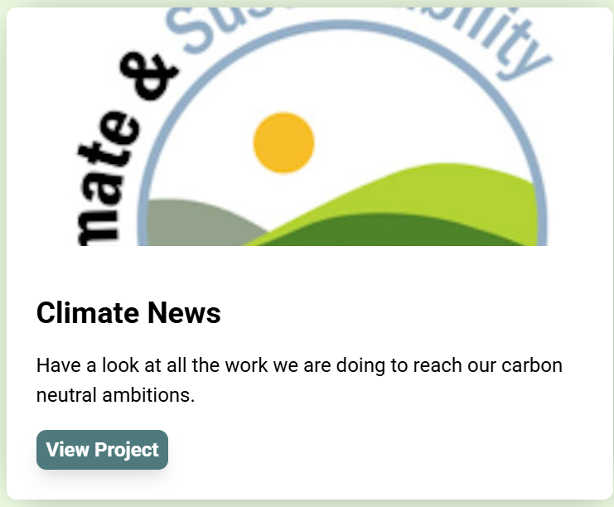
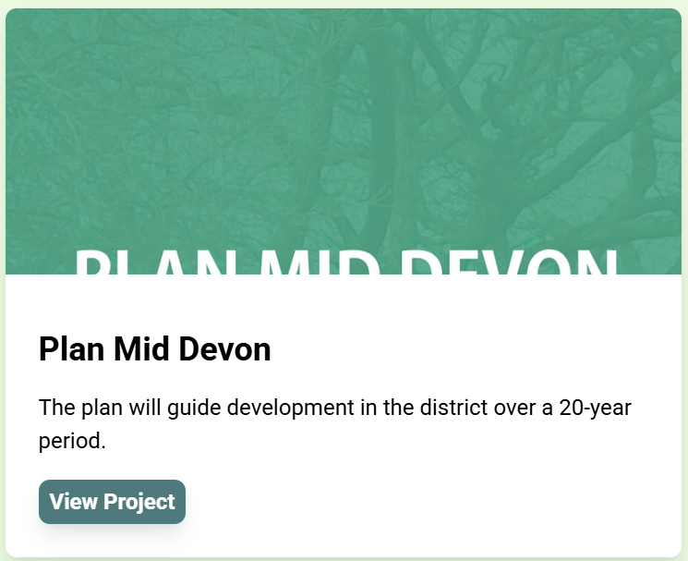
?
“We believe in empowering the community and giving everyone a voice...”
Notes:
1st Mid Devon Climate Forum this year.
Let's Talk Mid Devon
- residents, businesses, and organisations throughout the district have the opportunity to help shape the future of their community.
actively participate in surveys, polls, and discussions that address a wide range of local issues, initiatives, and policy decisions.
Whether it's suggesting improvements to Council services, offering insights on the future of Mid Devon through its local plan, or sharing ideas to tackle climate change together.

Slide 16
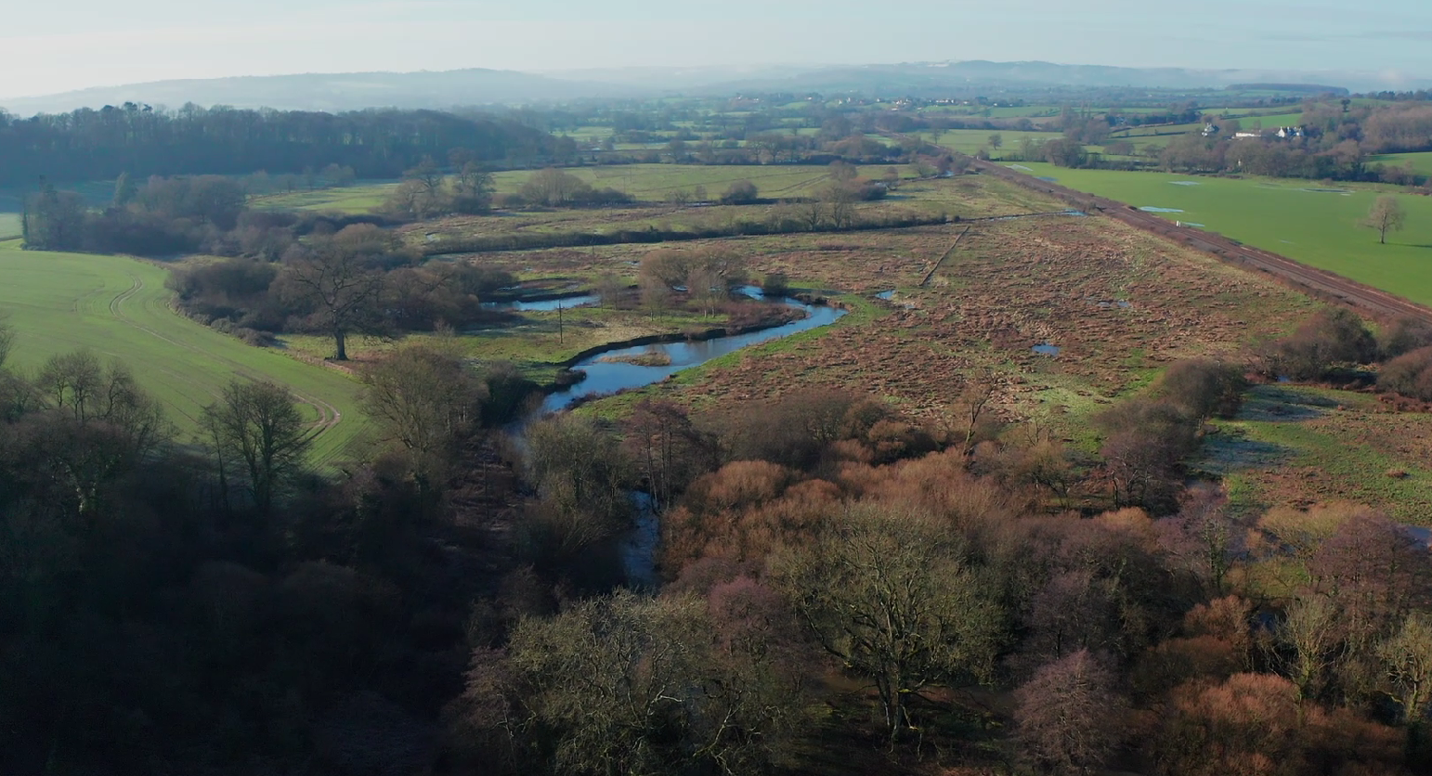
Thank You
Cllr Natasha Bradshaw
nbradshaw@middevon.gov.uk

